Slide 1
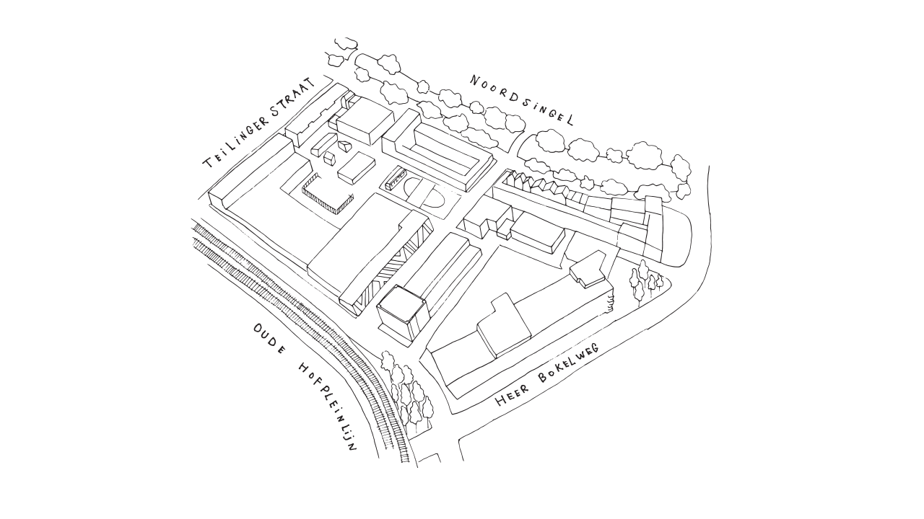
Het Gebouw
Syed Baqir Ali Kazmi
&
Jasper van der Vaart

Slide 2
Design Goals

Slide 3
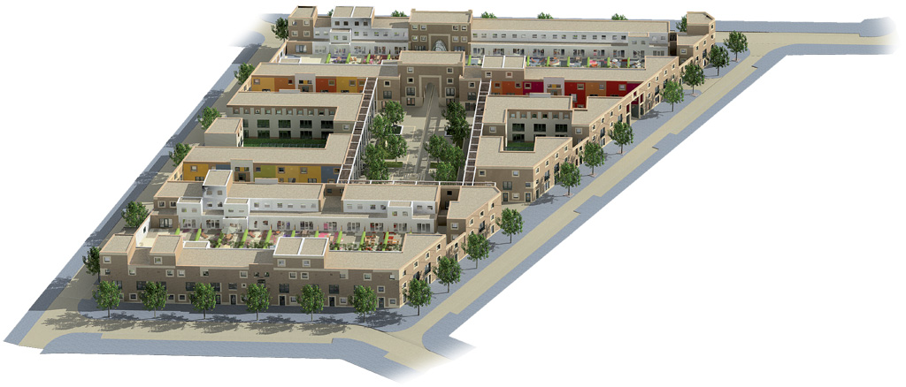
Design Goals

Slide 4
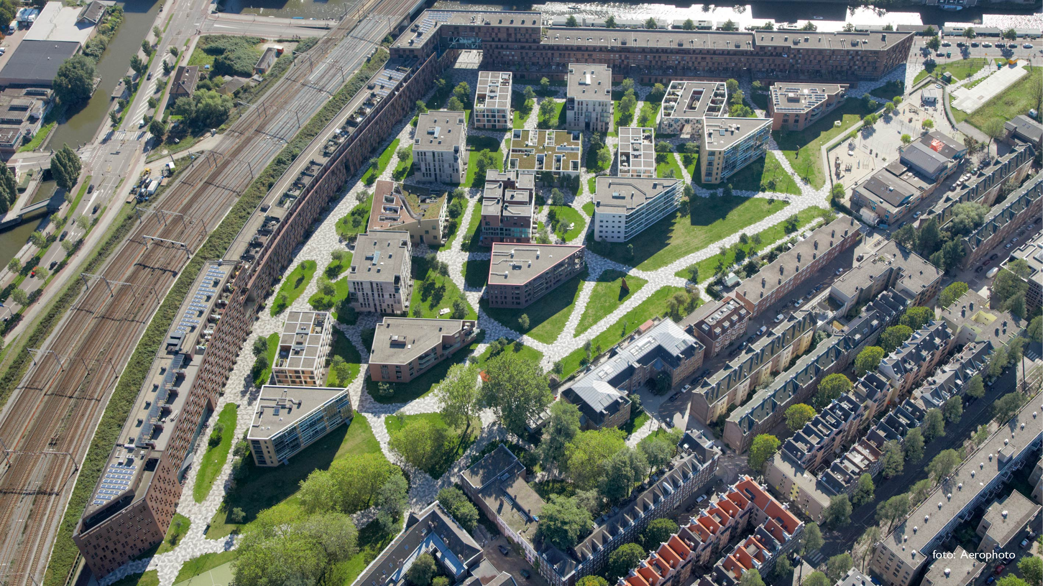
Design Goals

Slide 5
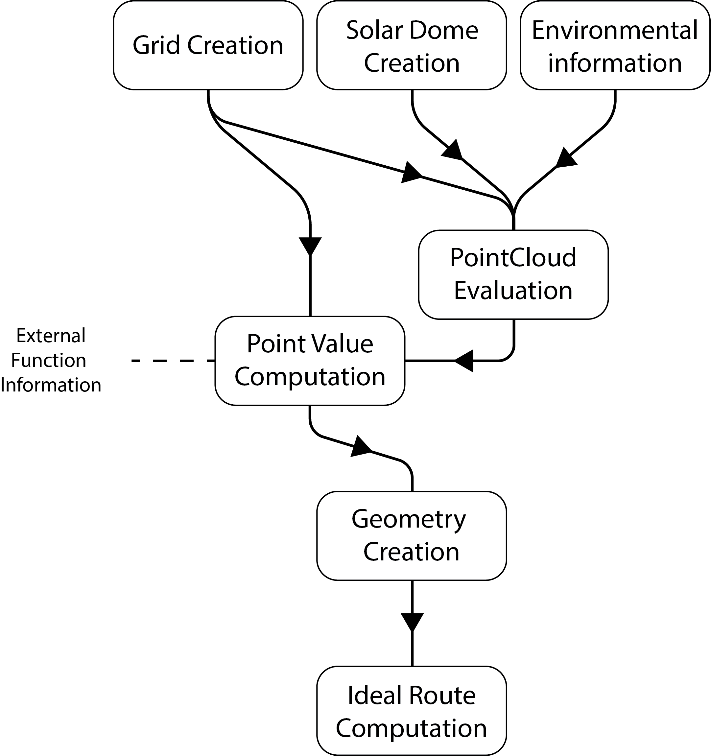
Overall Program

Slide 6
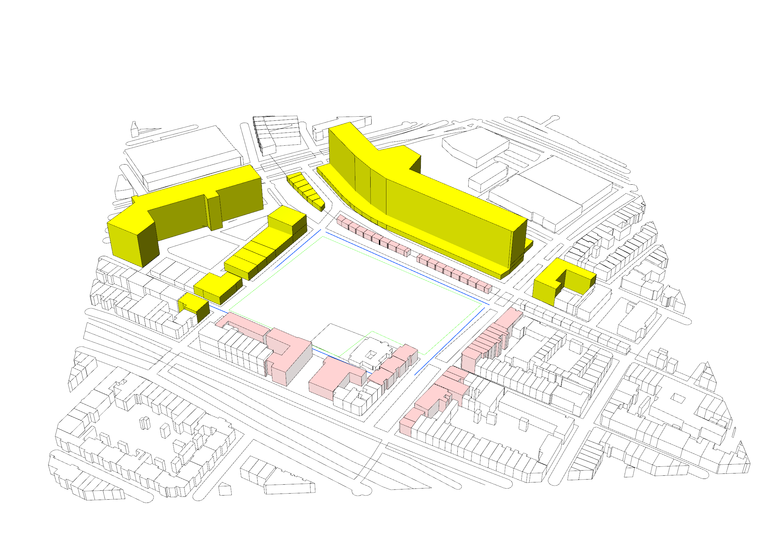
Environmental information

Slide 7
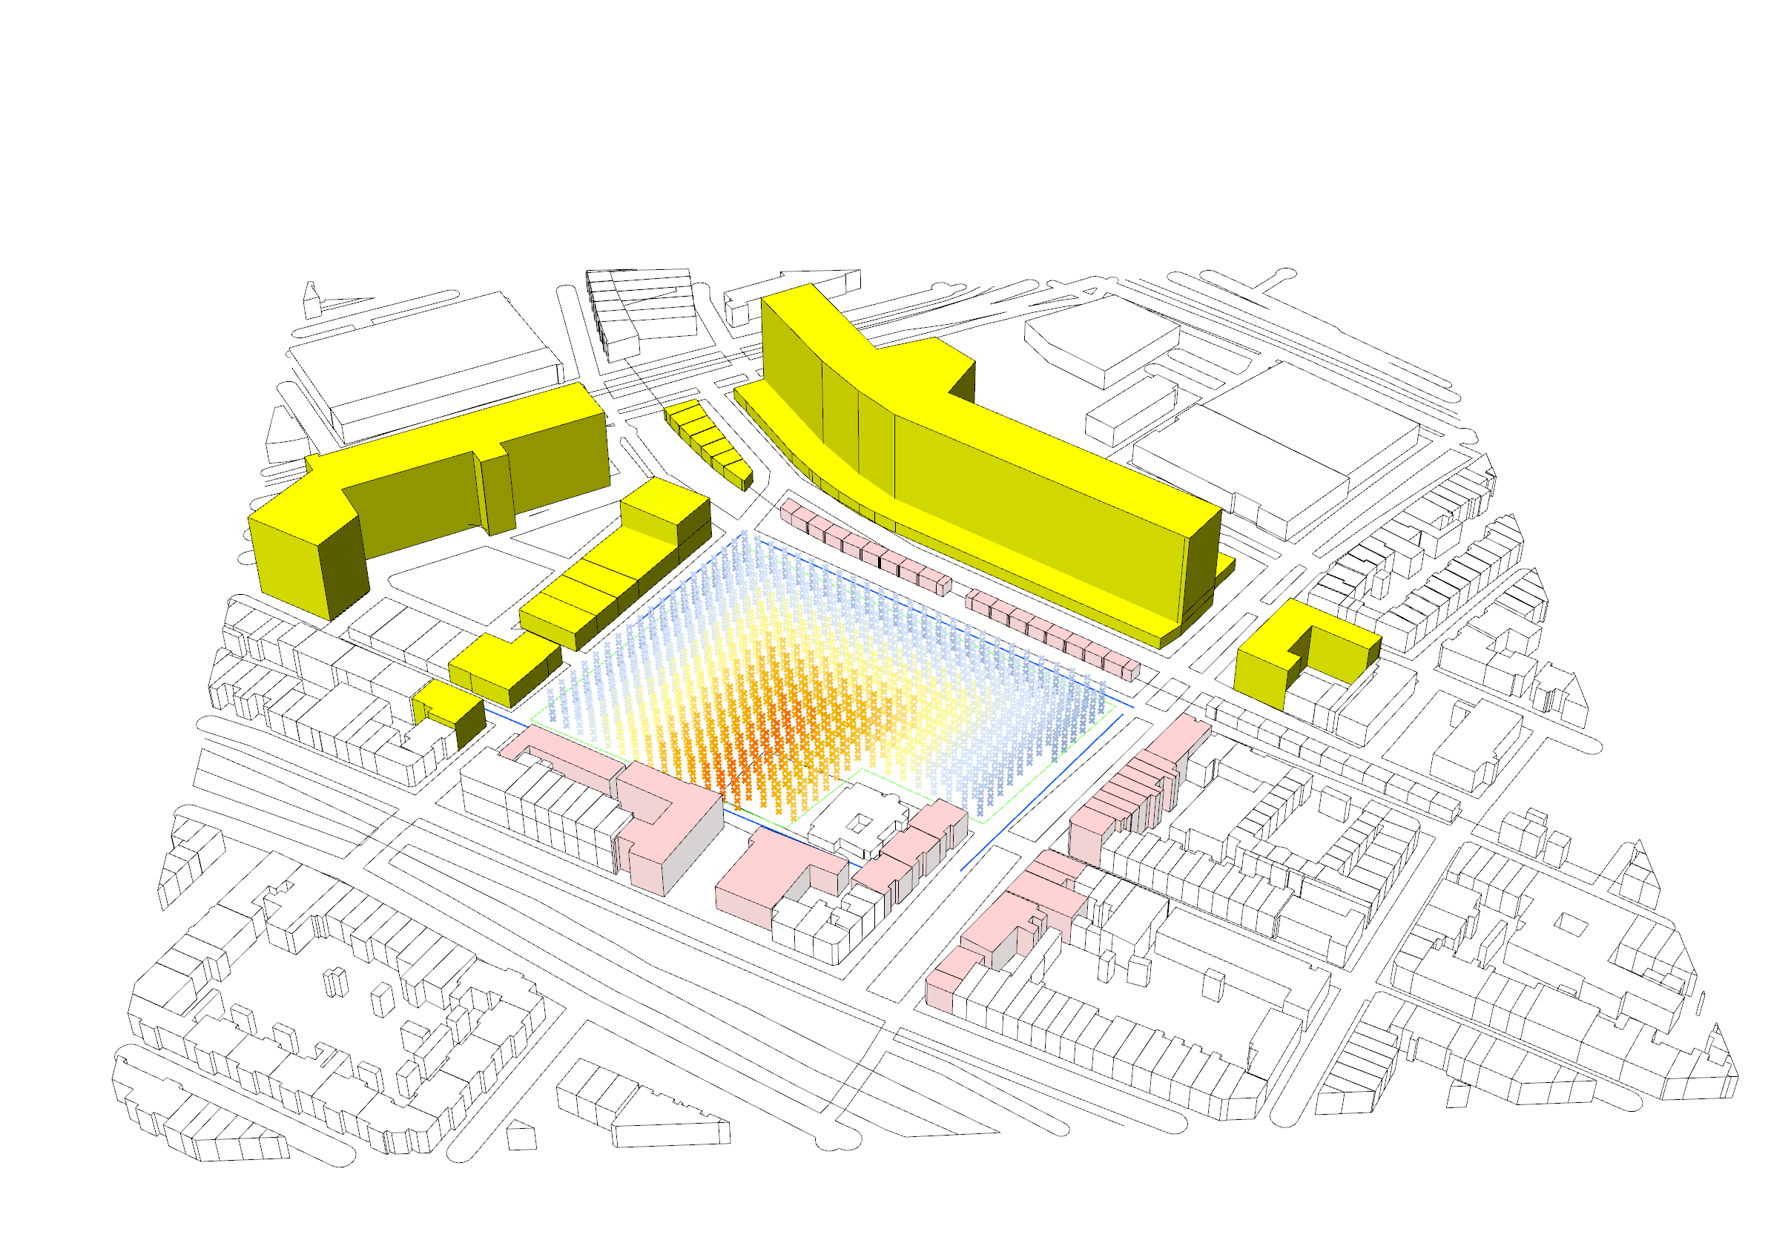
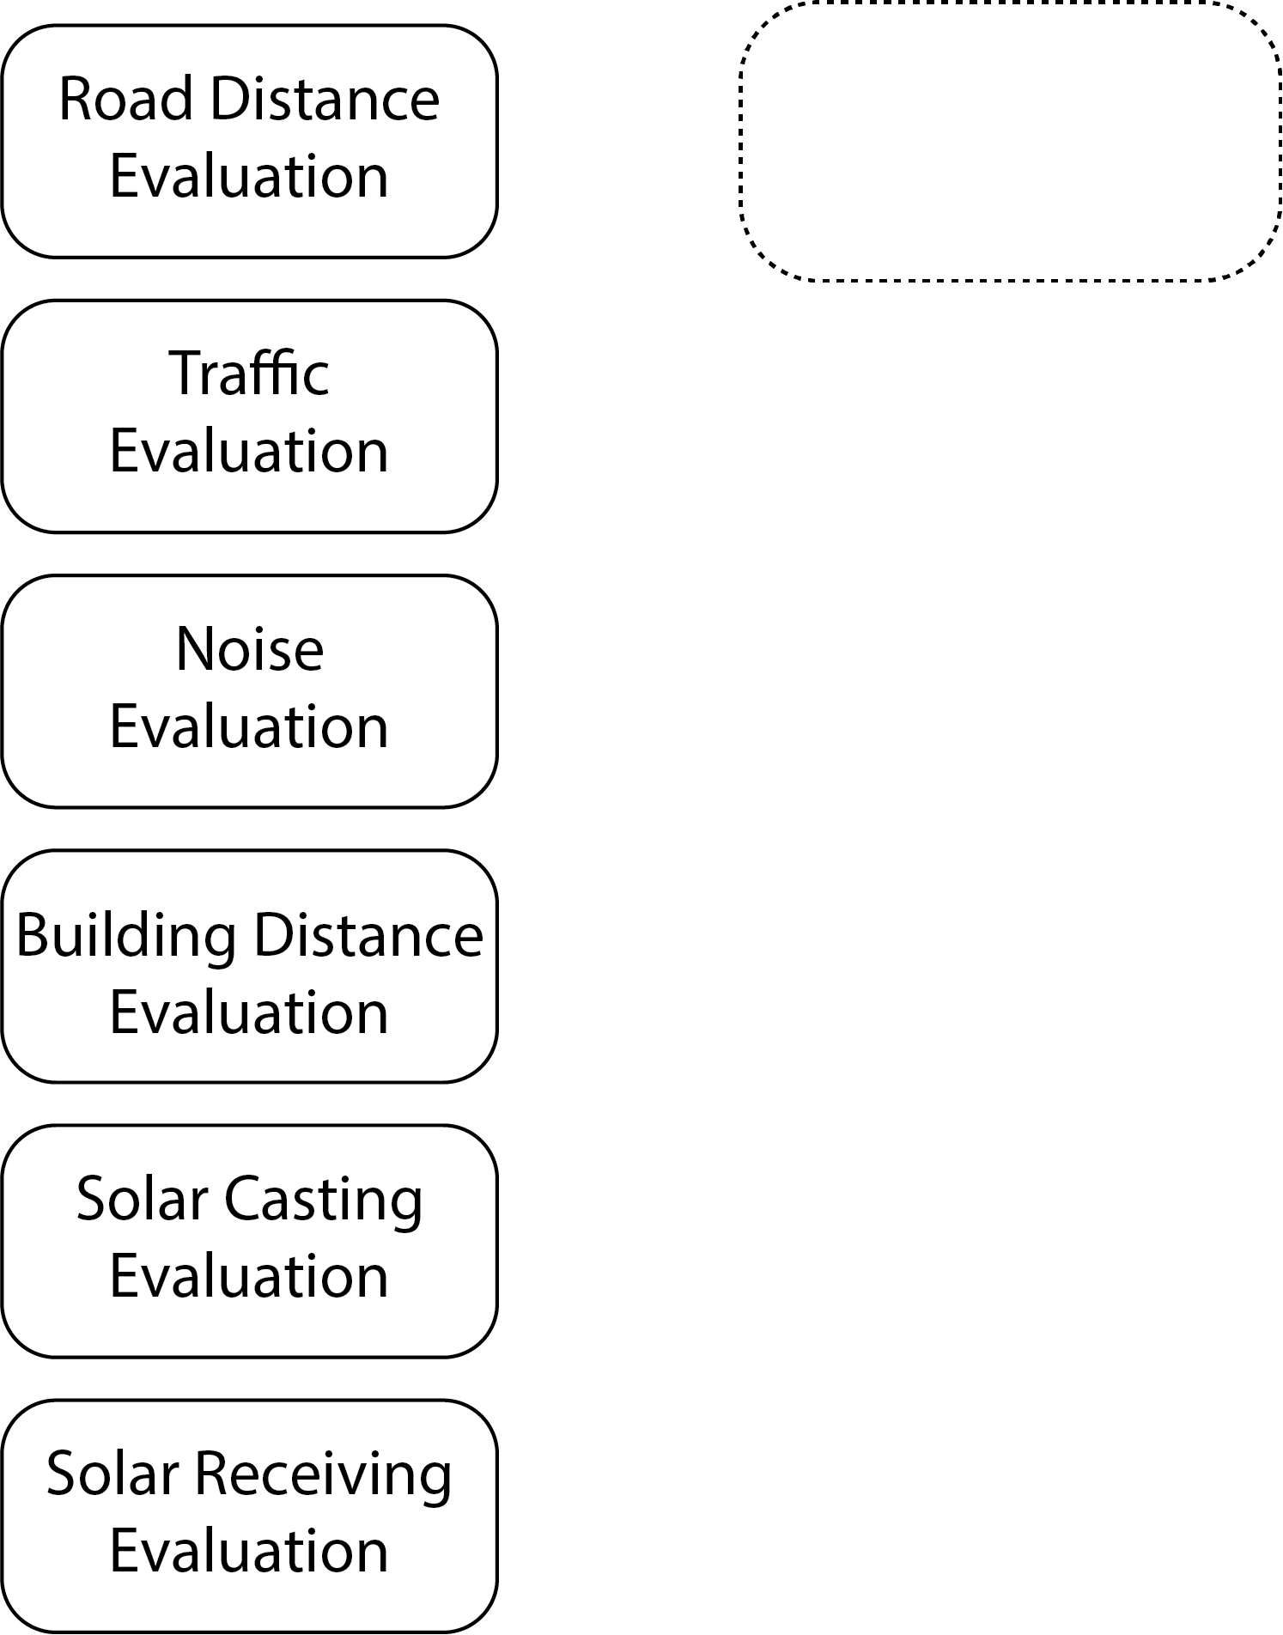
Point cloud Evaluation

Slide 8
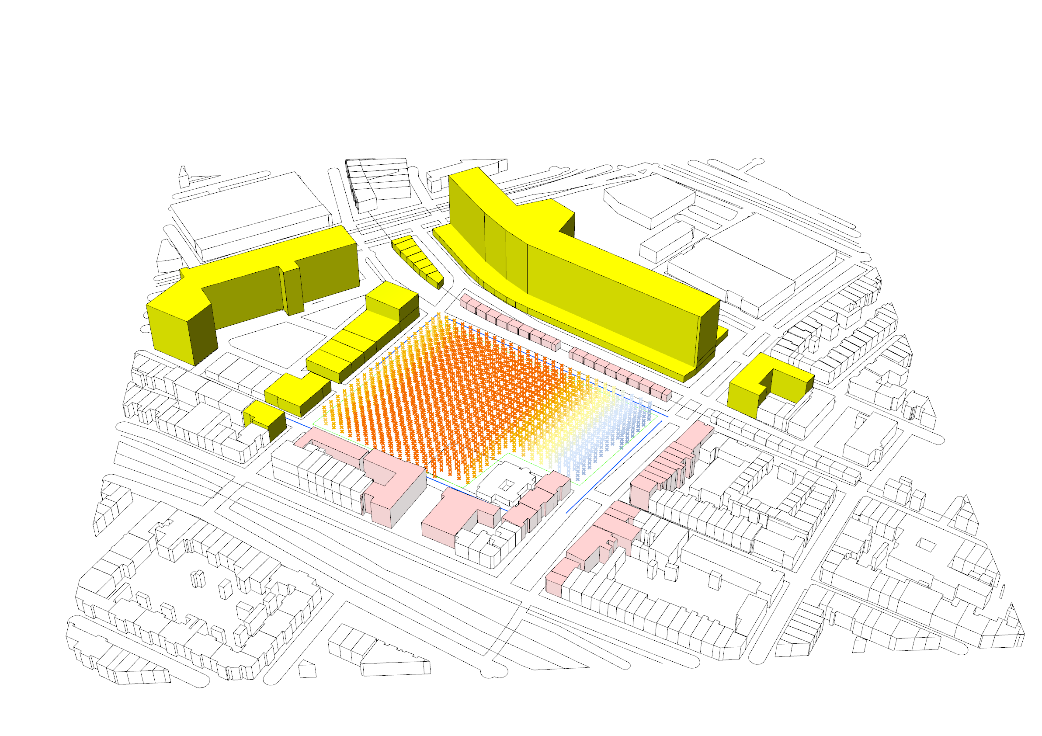
Point cloud Evaluation

Slide 9
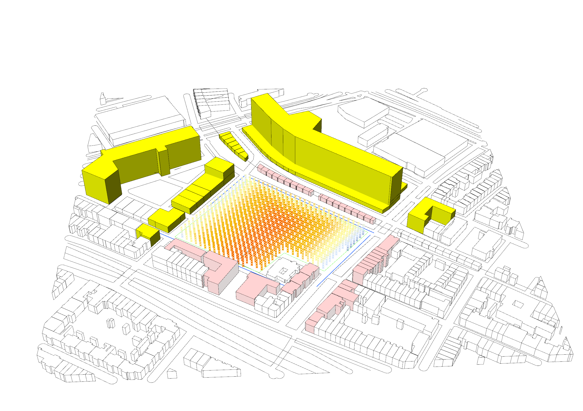
Point cloud Evaluation

Slide 10
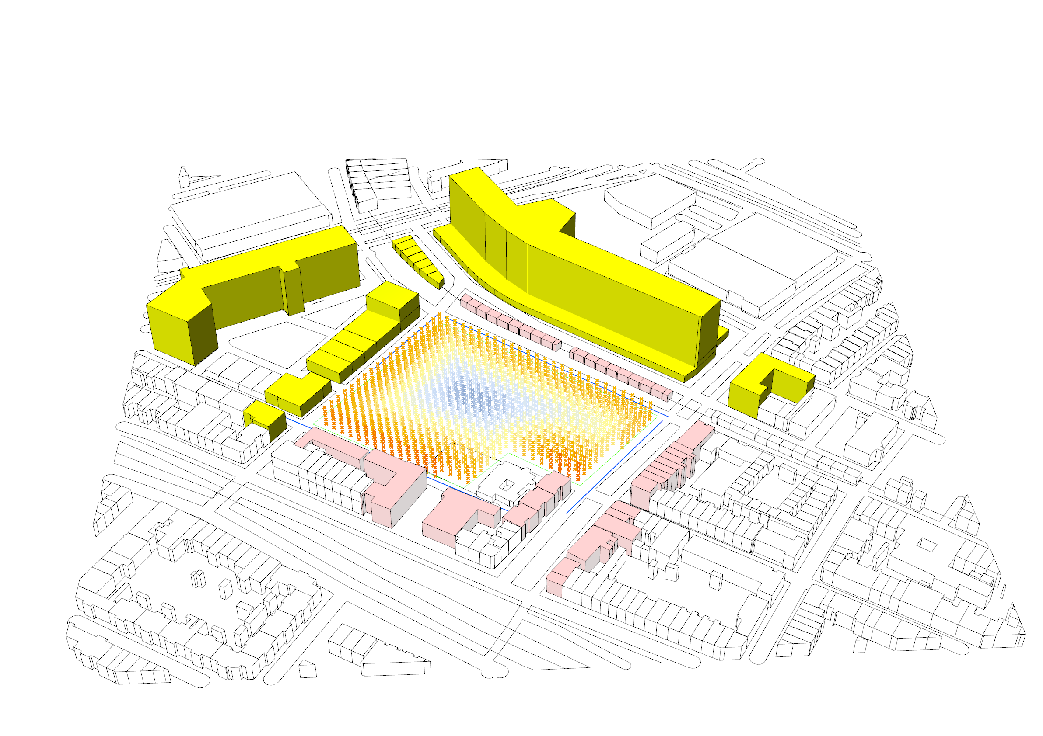
Point cloud Evaluation

Slide 11
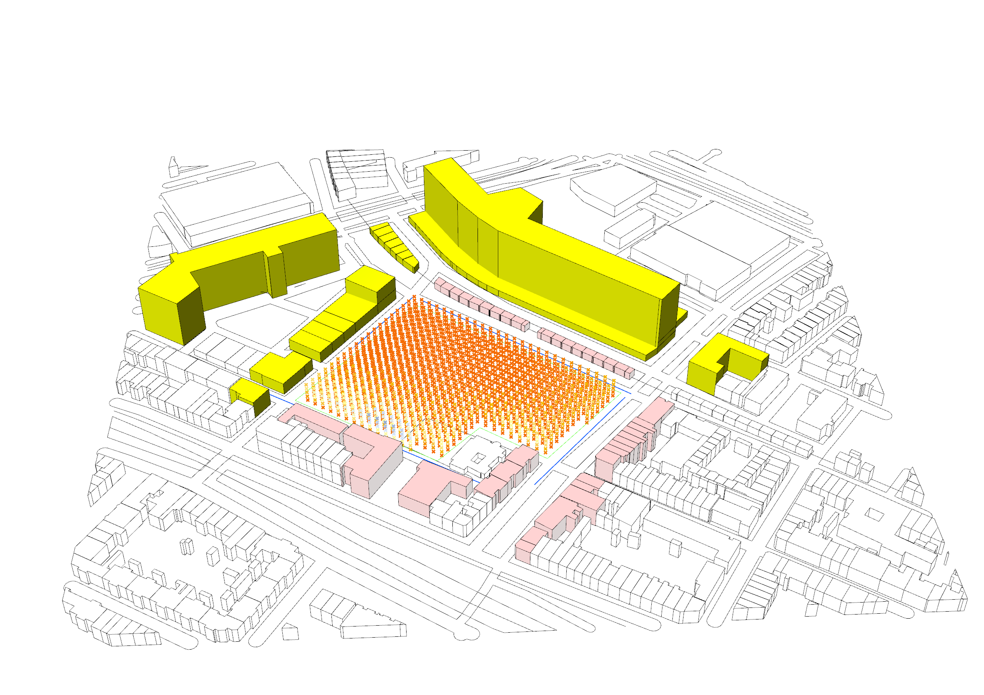
Point cloud Evaluation

Slide 12
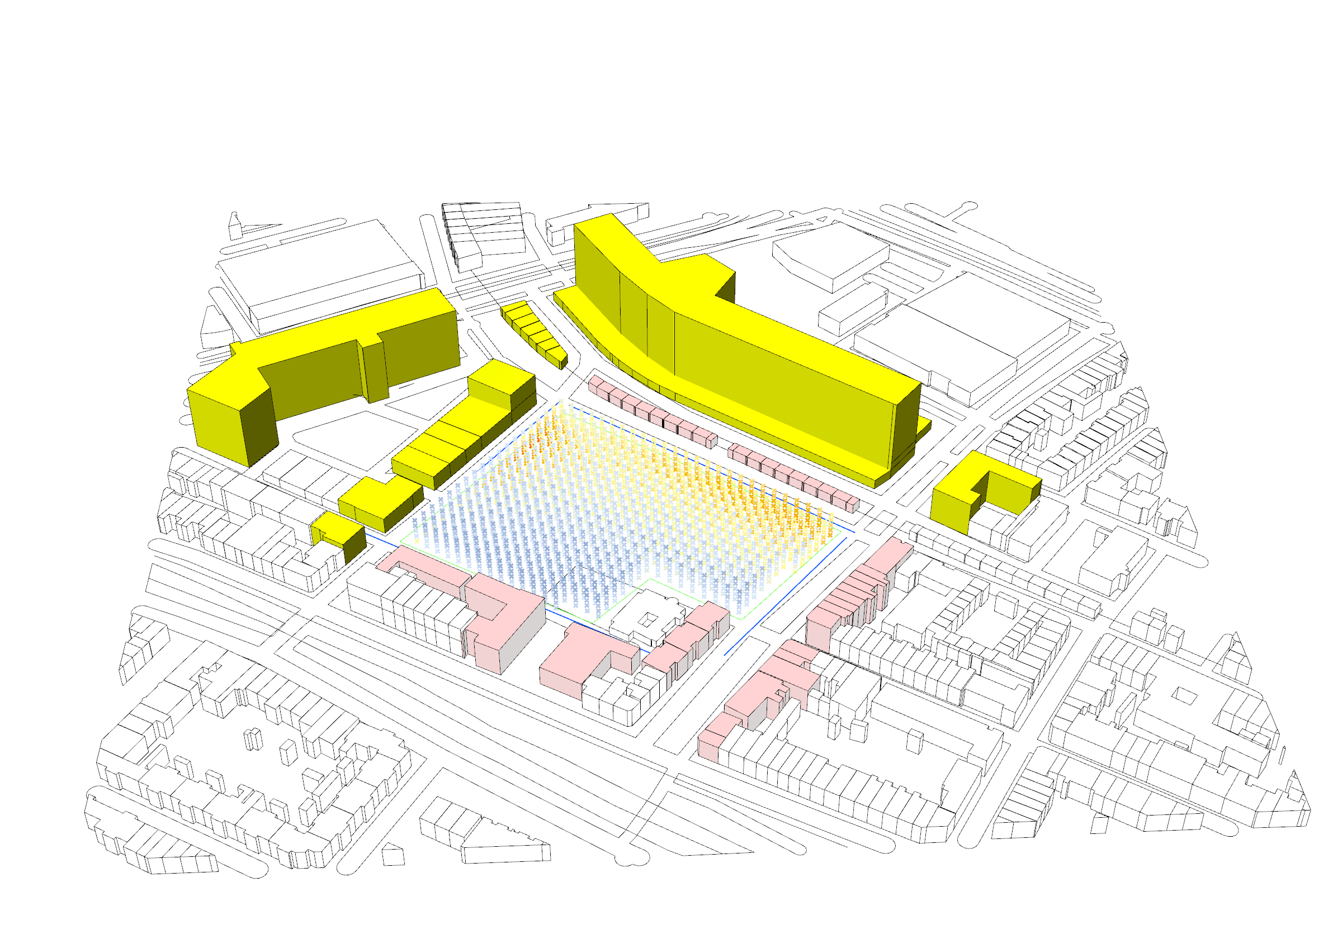
Point cloud Evaluation

Slide 13
Point Value Computation
Formula for the livability index: RoadDistance*w + distanceValue*w + SolarValue*w – ( NoiseValue / 45 )*w + 1.5 * TrafficValue*w

Slide 14
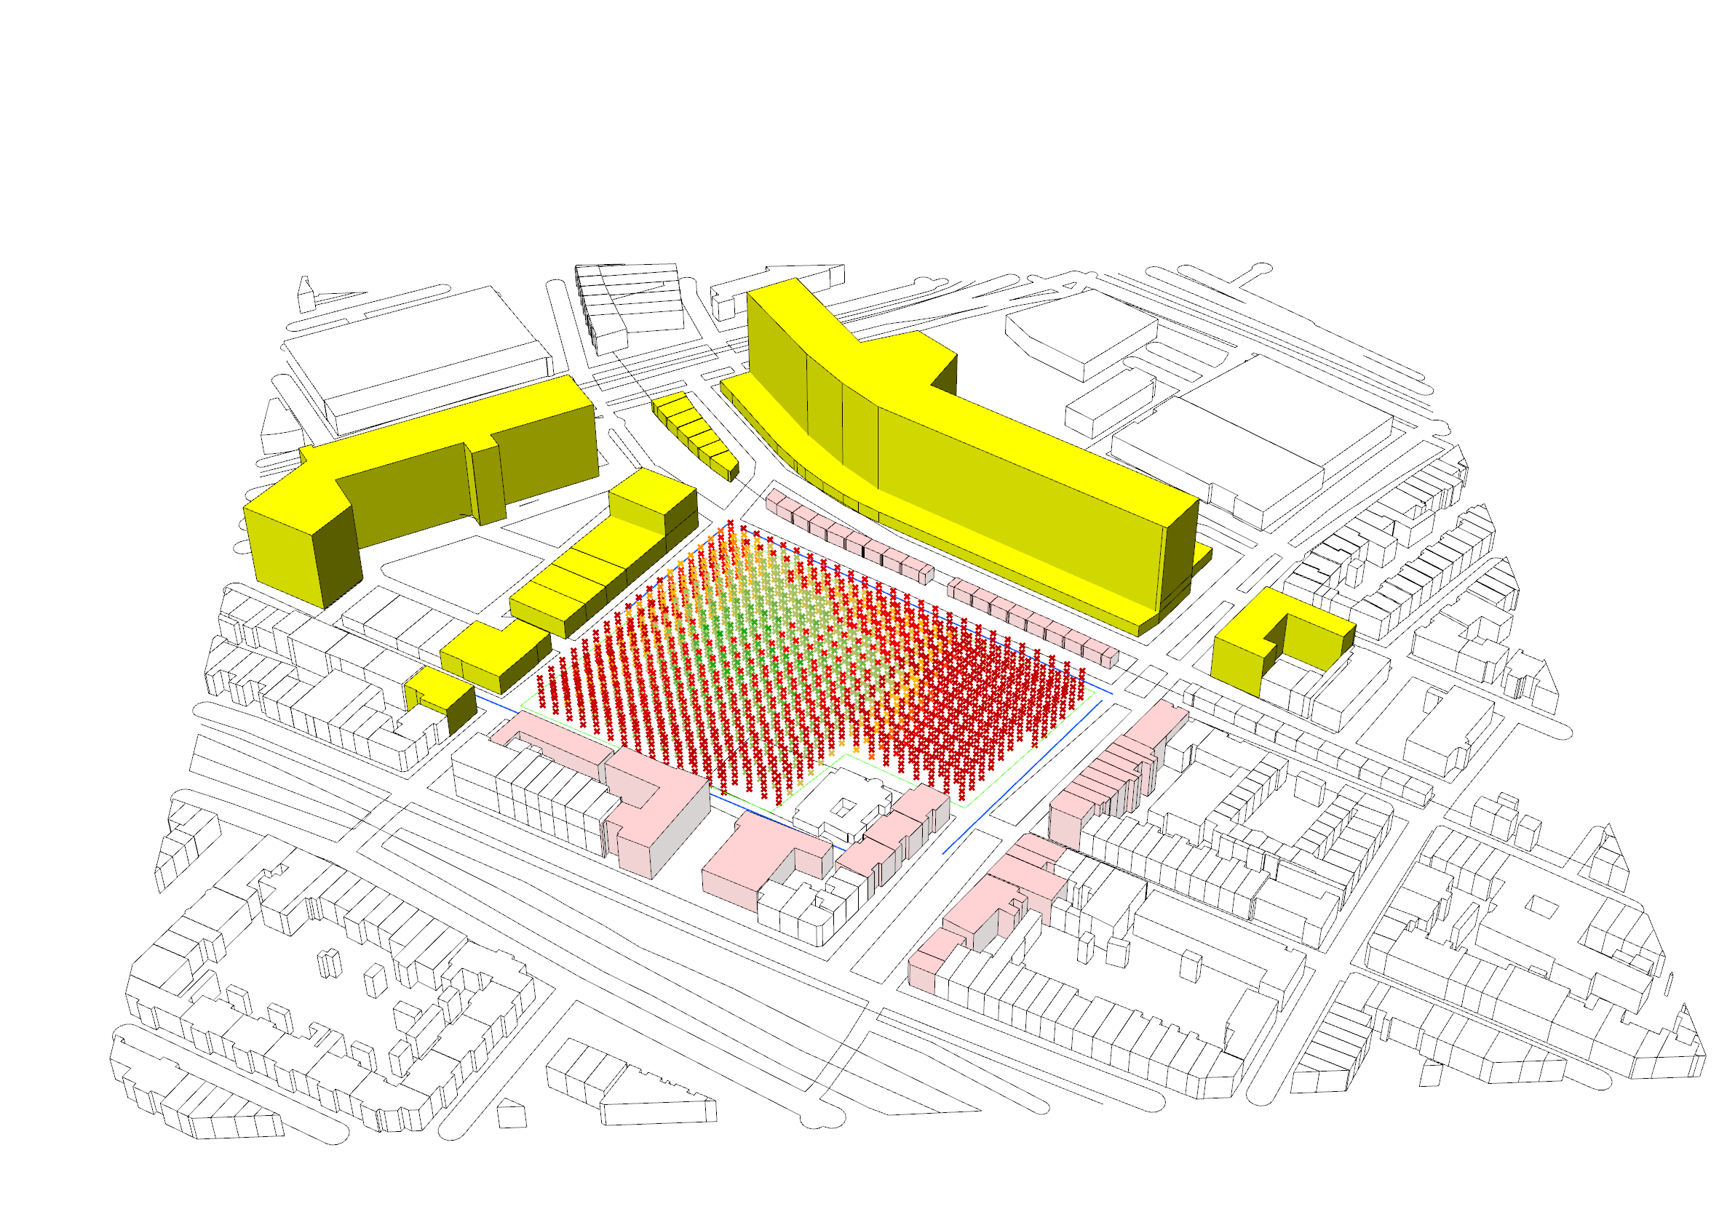
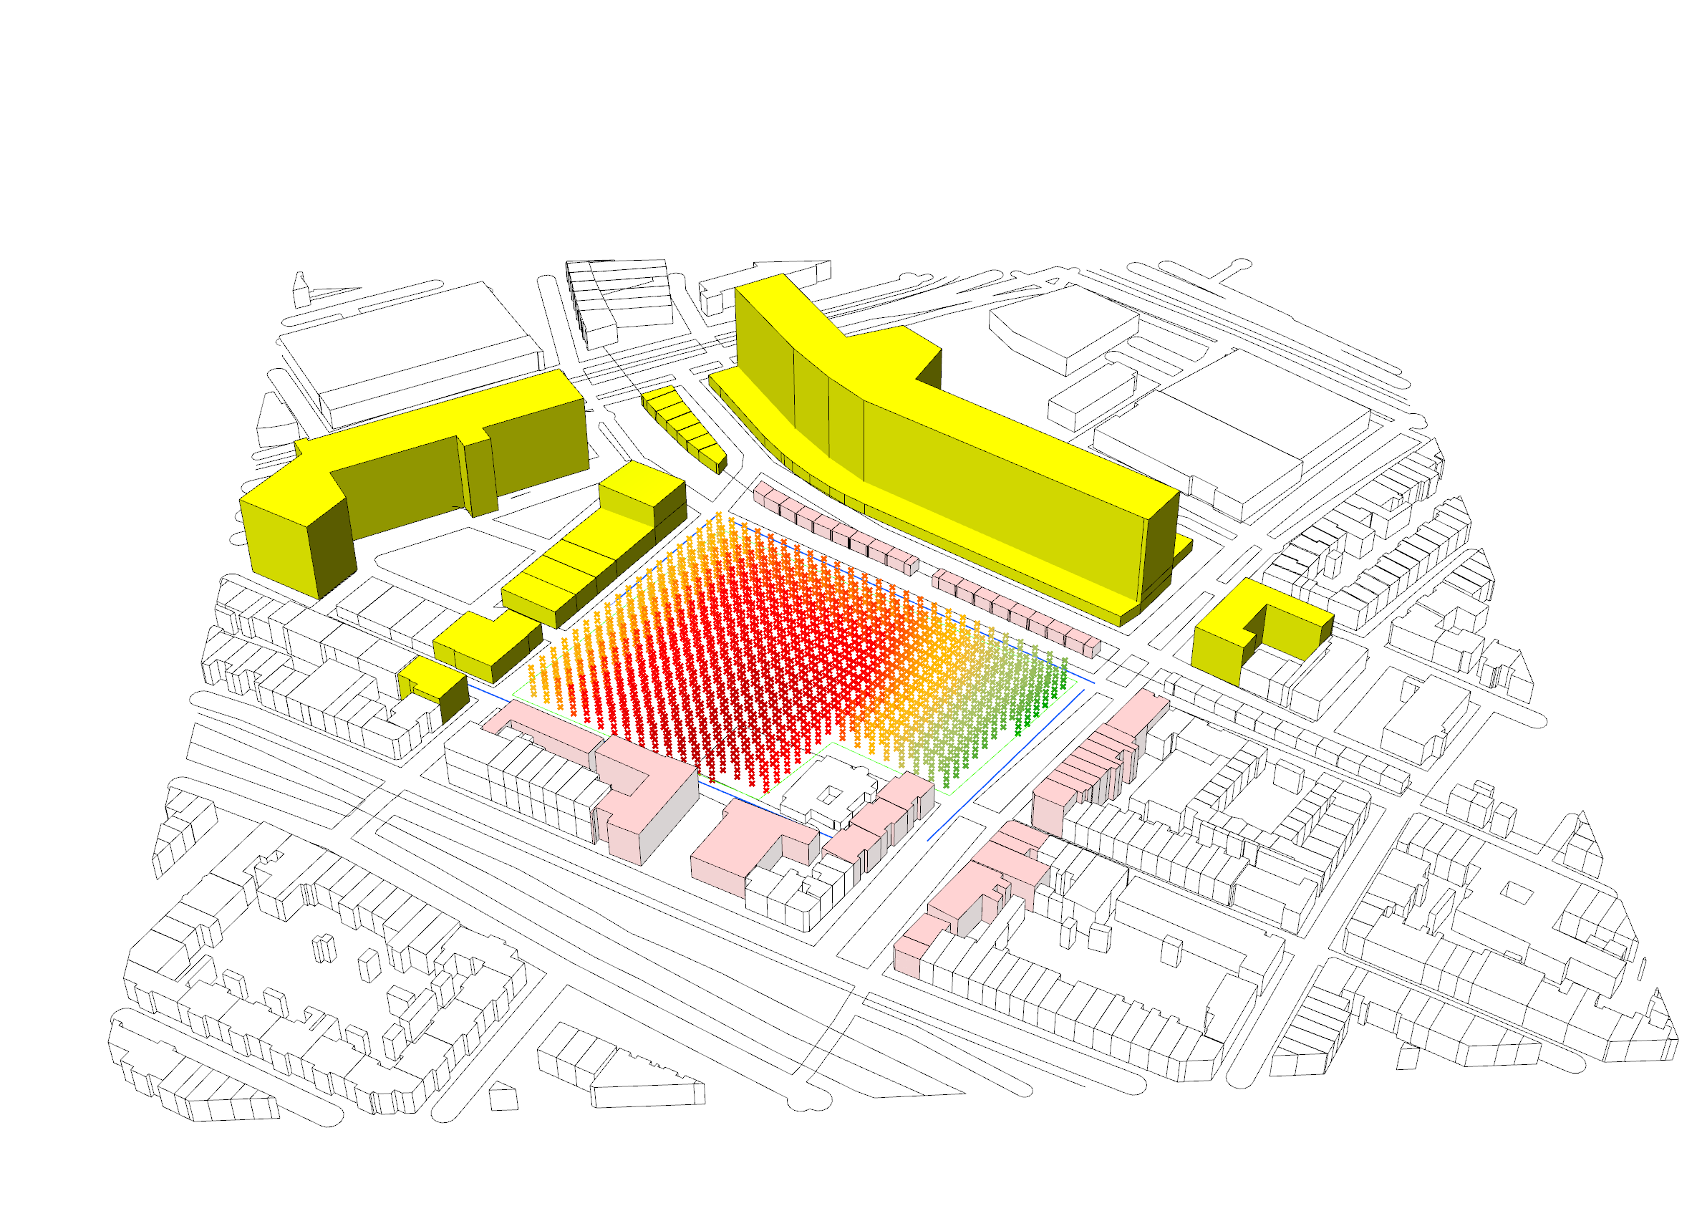
Point Value Computation

Slide 15
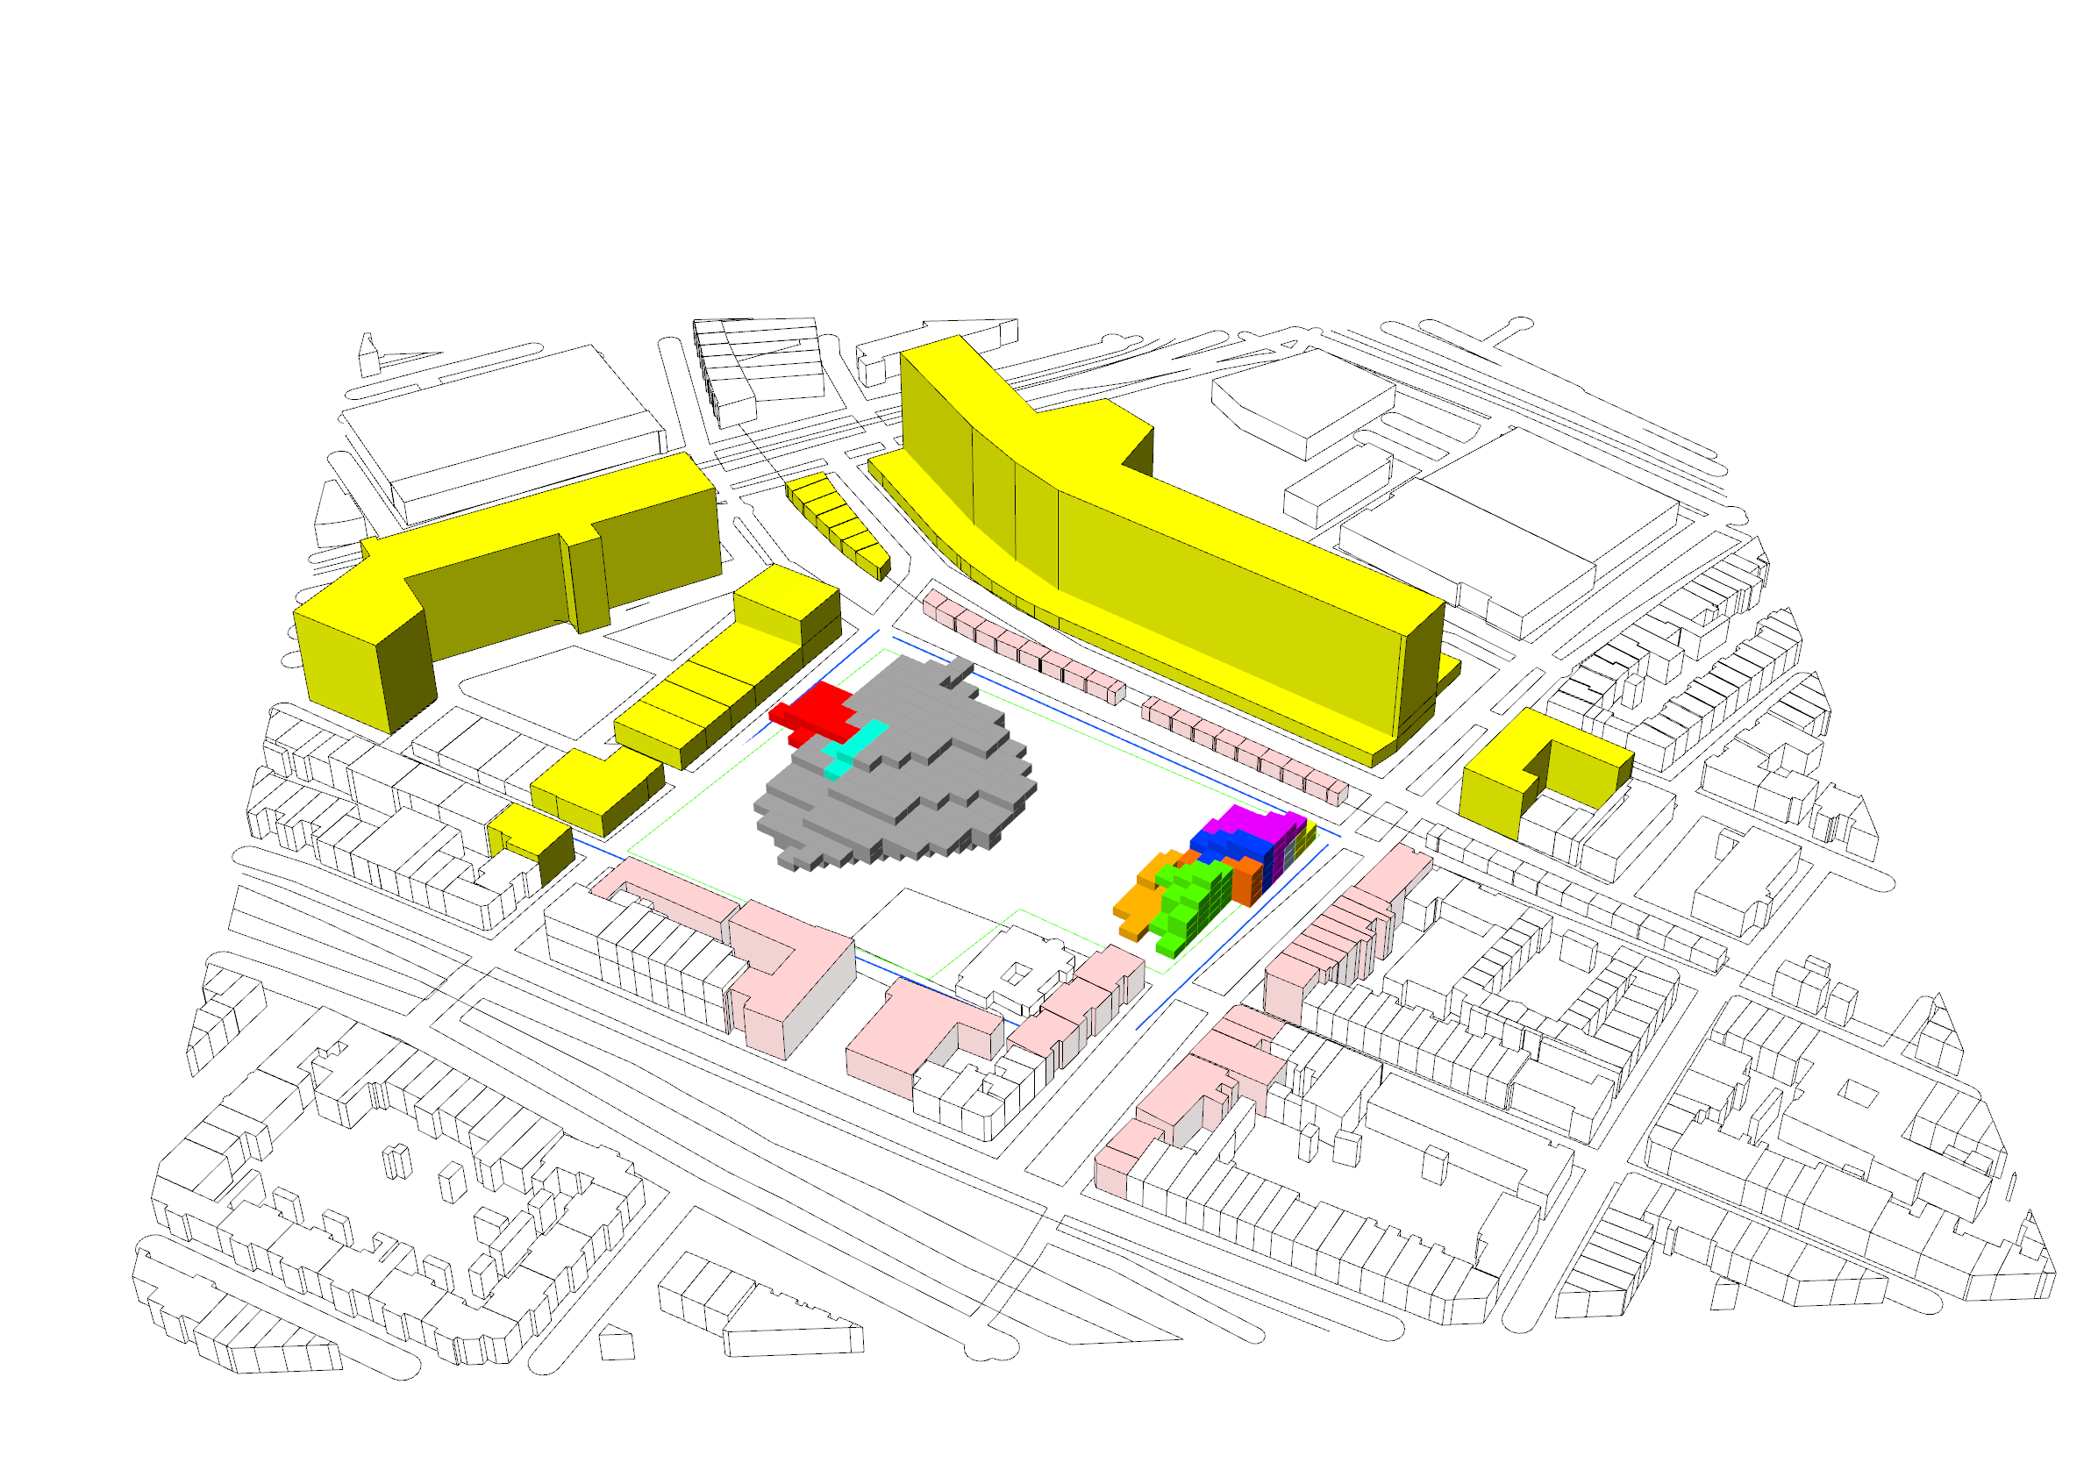
Geometry Creation

Slide 16
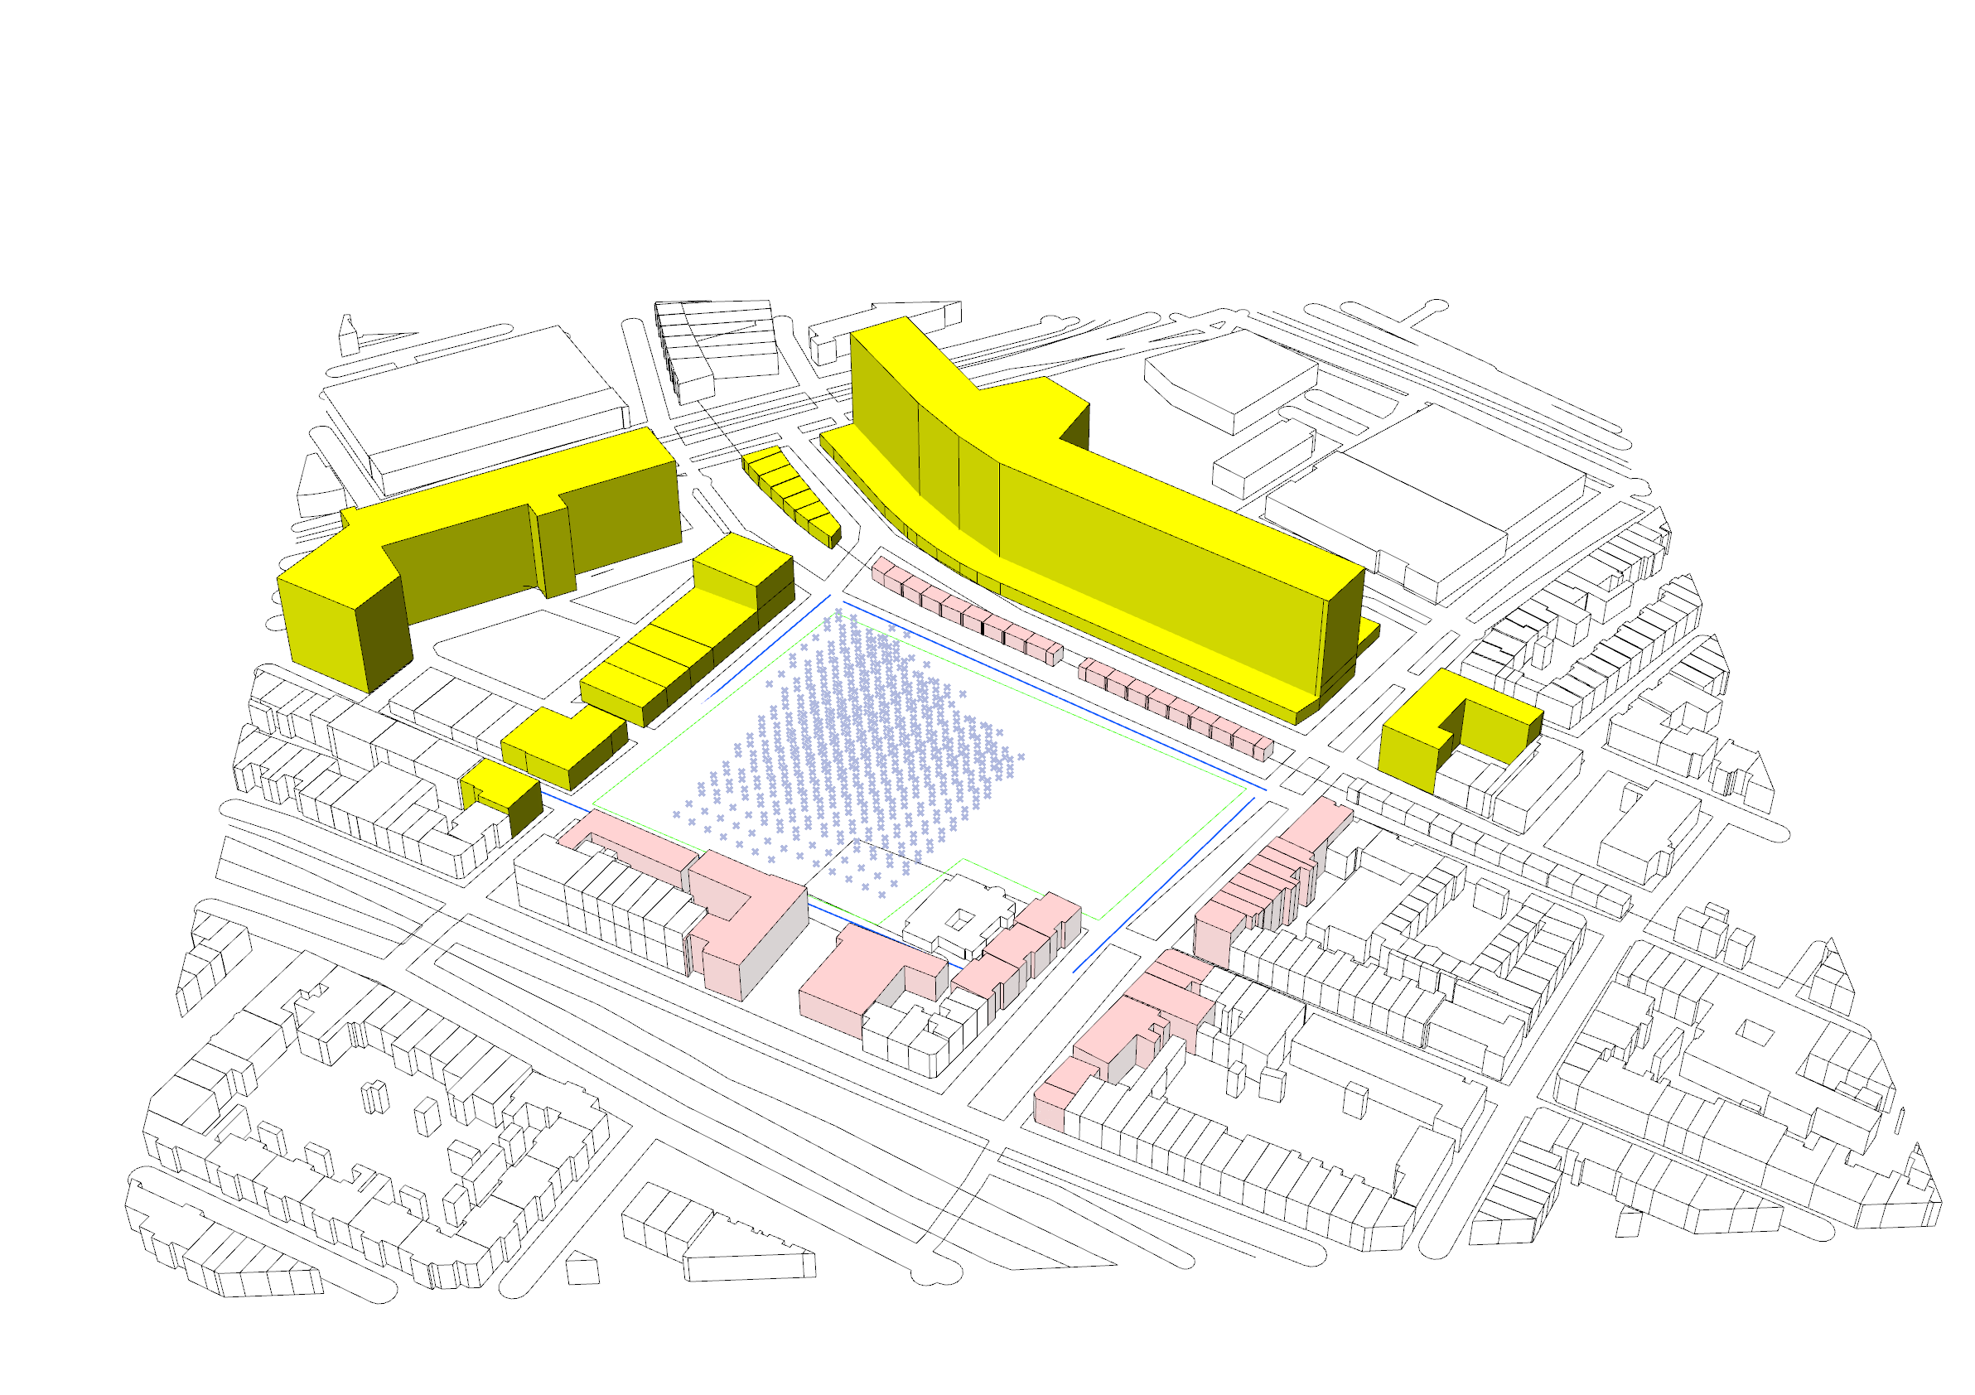
Geometry Creation

Slide 17
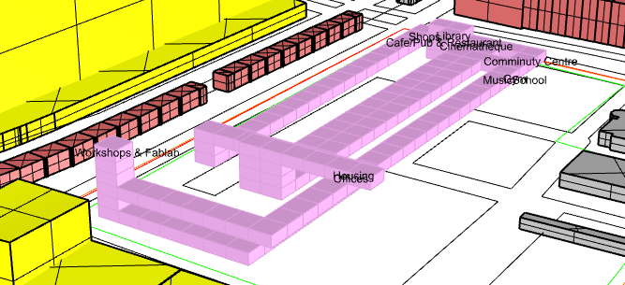
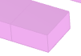
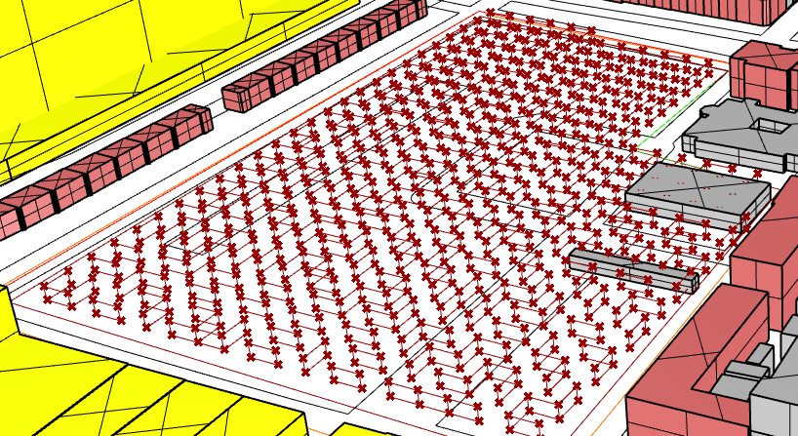
A* Algorithm
Ideal points (Best chosen points according to
point cloud and Growing algorithm)
Nodes as purple voxels representing shortest
path between start node and end node

Slide 18
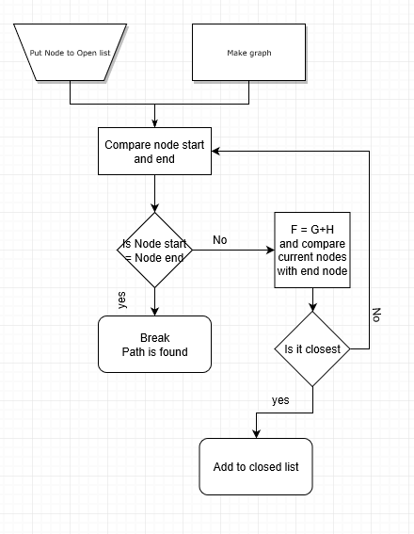
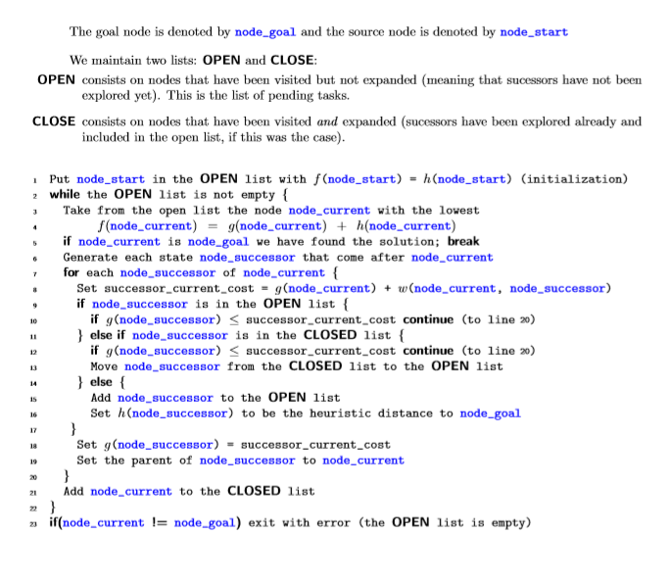
Path finding (A*)
http://mat.uab.cat/~alseda/MasterOpt/AStar-Algorithm.pdf

Slide 19
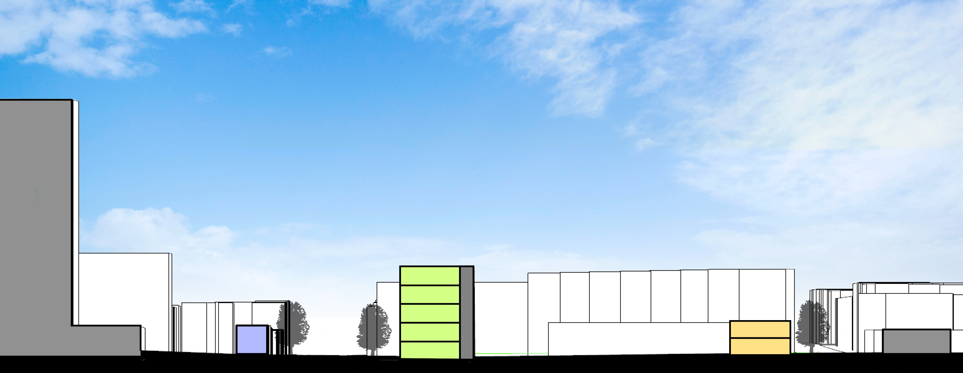
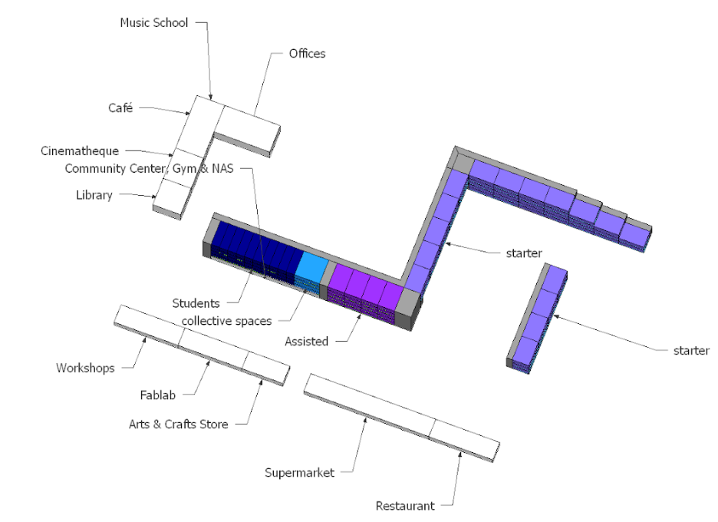
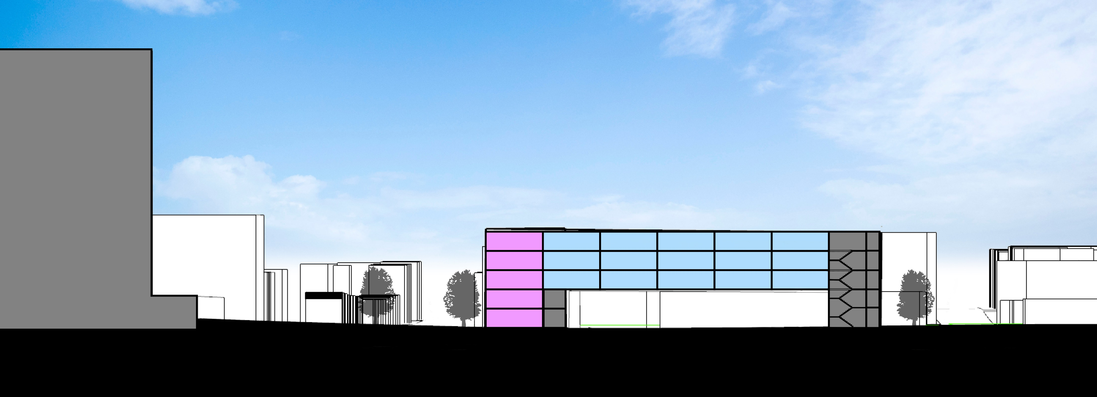
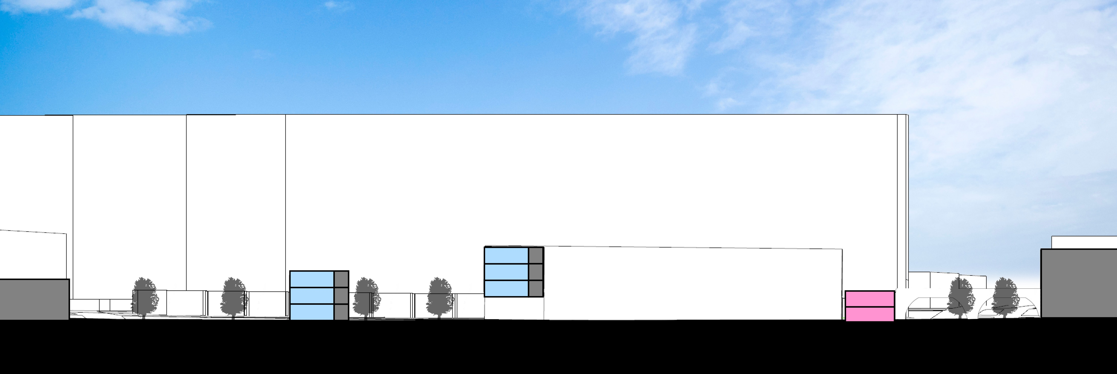
Design

Slide 20
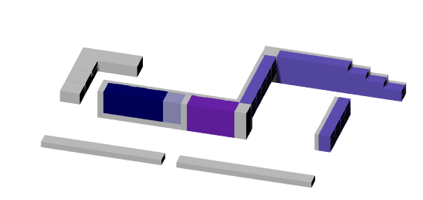
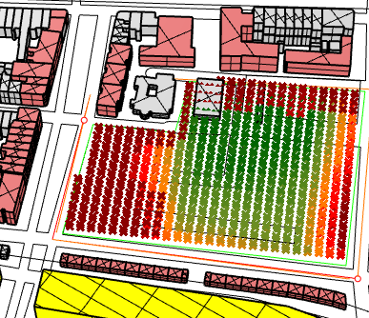
Point cloud and Design
Housing

Slide 21
Point cloud and Design
Housing
students
Assisted
Starter
Groups | Areas (m^2)
Starter housing | 4000
Assisted | 1000
Student | 1000
Total | 6000

Slide 22
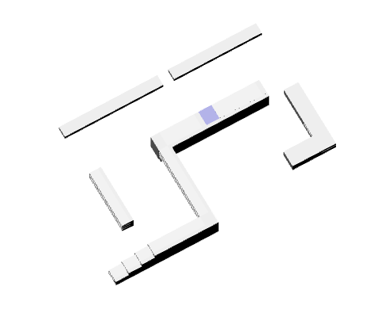
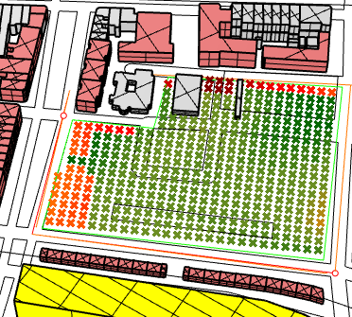
Point cloud and Design
Offices

Slide 23
Point cloud and Design
Offices
Offices 2 storage
Group | Area (m^2)
Offices | 400

Slide 24
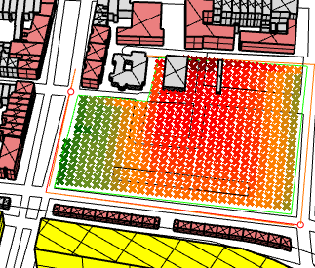
Point cloud and Design
Workshop/fablab
Library

Slide 25
Point cloud and Design
Workshop/fablab
Library
Library
Workshop/ Fablab
Groups | Area (m^2)
Workshop | 150
Fablab | 150
Library | 200
Total | 500

Slide 26
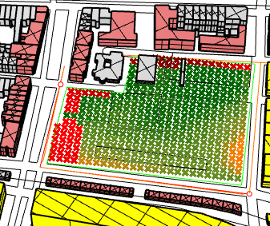
Point cloud and Design
Community centre

Slide 27
Point cloud and Design
Community center
Community center / Gym
Groups | Area (m^2)
Community center | 140
Gym | 180
Total | 320

Slide 28
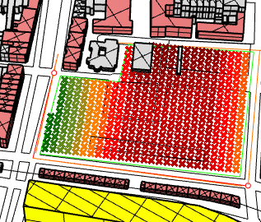
Point cloud and Design
Cinematheque

Slide 29
Point cloud and Design
Cinematheque
Cinematheque
Group | Area (m^2)
Cinematheque | 215

Slide 30
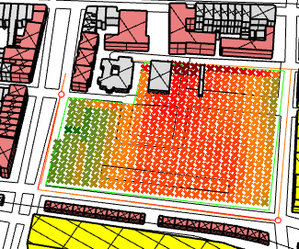
Point cloud and Design
Café/Pub &
restaurant

Slide 31
Point cloud and Design
Café/Pub &
restaurant
Café ground floor
Restaurant
Groups | Area (m^2)
Café | 80
Restaurant | 150
Total | 230

Slide 32
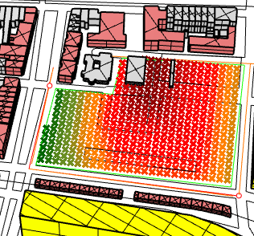
Point cloud and Design
Shops

Slide 33
Point cloud and Design
Shops
Supermarket
Art & craft
store
Groups | Area (m^2)
Supermarket | 300
Art & Craft store | 95
Total | 395

Slide 34
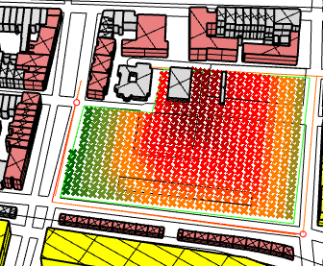
Point cloud and Design
Music school

Slide 35
Point cloud and Design
Music school
Music school
Group | Area (m^2)
Music school | 200

Slide 36
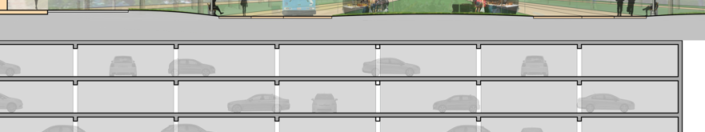
Underground parking
Total: 60 units
Total area: 1500 m^2

Slide 37

Checklist
Total Area = 18,560 m^2 => 50% of 18,560 = 9280 m^2
Area build: 200 + 395 + 230 + 215 + 320 + 500 + 400 + 6000 = 8260 m^2 = 44% Area used
100 – 44 = 56% Green
Student housing: 40 units
Assisted living: 20 units
Starter housing: 60 units
Communal spaces
(For underground parking see Program of Requirements)
Design goals qualitative and quantitative optimised (through point cloud and logical reasoning)

Slide 38
Thank you for your attention

